Slide 1
Building Partnerships to Build Value Pricing and Promoting Products & Services
June 17th, 2015
Presented by Brian MacLeod, Pricing and Promotions

Slide 2
Objectives
Overview of Pricing & Promotions
What is Value?
How do you build it? How do you measure it?
Power of Partnerships
Refining & Creating Key Pricing Metrics
Data Visualization
Insights & Communication
Functional Landscape of P&P
Shared Wins
© 2014 Lowe’s. All rights reserved. CONFIDENTIAL, intended for internal distribution only. .

Slide 3
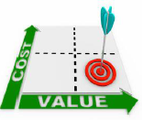
Reason for Being
Introduction
At the core, Pricing and Promotions exists to create a shared value for Lowe’s Customers and Stakeholders by delivering simple, seamless and omni-channel pricing/promotional plans for products, services and credit… to help people love where they live.
We Must Be Customer-Focused & Data-Driven
Success will be achieved when ‘Customers perceive Lowe’s prices and promotions as fair and competitive within the Omni-channel market’ as measured by value perception scores
© 2014 Lowe’s. All rights reserved. CONFIDENTIAL, intended for internal distribution only.

Slide 4
Functional
Areas
Pricing
&
Promotions
Value Strategy
Planning & Implementation
Product, Service, Credit & Pro Strategies
Analytics & Predictive Modeling
Systems & Tools
Execution
Operations
Item Recommendation & Placement by Vehicle
Traffic/Promo Planning
Assessment
Recommendation & Integration
Communication & Process
Promotional Seasonal Strategy
Competitive Intelligence
SOS Pricing & Profitability
© 2014 Lowe’s. All rights reserved. CONFIDENTIAL, intended for internal distribution only.

Slide 5
What is Value?
Introduction
: a fair return or equivalent in goods, services, or money for something exchanged
: relative worth, utility, or importance <a good value at the price>
© 2014 Lowe’s. All rights reserved. CONFIDENTIAL, intended for internal distribution only. .

Slide 6
Progression of Economic Value
Experiences
Customization
Stage
Services
Customization
Deliver
Commoditization
Goods
Make
Commoditization
Commodities
Extract
© 2014 Lowe’s. All rights reserved. CONFIDENTIAL, intended for internal distribution only. .

Slide 7
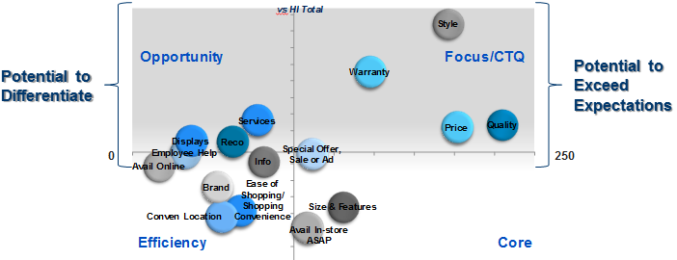
Laminate Flooring Critical Purchase Drivers: Quality, Price, Style & Warranty
Purchase Drivers
© 2014 Lowe’s. All rights reserved. CONFIDENTIAL, intended for internal distribution only. .

Slide 8
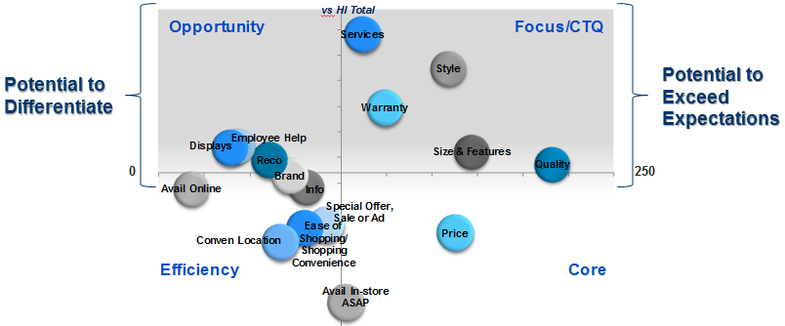
Patio Door Critical Purchase Drivers: Quality, Size & Features, Style, Warranty and Services
Purchase Drivers
© 2014 Lowe’s. All rights reserved. CONFIDENTIAL, intended for internal distribution only. .

Slide 9


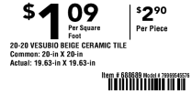
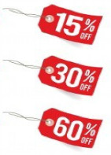
Consumer Perception of Value
Data Insights
Customer
Competition
Prod/performance
Military Discount
Store Control Pricing
Price Match Guarantee
Price Suspension/Natural Disaster
Additional Customer Influencers
Regular Pricing
Competitive Base Pricing
Benchmark/KVI Lists
Localized
Channel Pricing
Private Brand
Pro
Services
Markdown
Lowe’s Value Strategy
Promoted
- Traffic Focused
- Promo Selection
Promo by Channel
Credit
Flex Space
Lowe’s delivery on business objectives through building a pricing & promotional strategy that has a clear shared value for Customers and Lowe’s
Personalized
Coupons
Loyalty/Val Prop
Digital Engagement
Future Workstreams
© 2014 Lowe’s. All rights reserved. CONFIDENTIAL, intended for internal distribution only.

Slide 10
Which elements of VALUE make Lowe’s meaningfully unique to our customers? Which elements differentiate Lowe’s from competitors?
Value Equation
Product Elements
Quality
Features
Brand
Selection
Services Elements
Delivery
Installation
Assembly
Credit
Experience Elements
Convenience
Customer Service
Education
Environment
+
+
Customer-Perceived Value
=
Price Elements
Regular Price
Promotion
Loyalty
Bundles / Projects
Financing / Payments
© 2014 Lowe’s. All rights reserved. CONFIDENTIAL, intended for internal distribution only. .

Slide 11
Elasticity vs. Demand
Data:
Elasticity Redefined
Theoretically, only two things should change the Elasticity for a given item:
The item’s price. As price changes, the elasticity will change, because now the point of reference has changed.
Ex: An item costs $5 and has an elasticity of 1.5. Based on this info, we lower the price 5% to $4.75. I would expect the elasticity to now be higher, since a decrease in price from the “new price” will be met with even more demand.
Change in customer mindset. If something changes that makes an item more or less desirable (or necessary), then a change in elasticity is expected.
Ex: A recent study shows that one type of light bulb may be linked to autism. I would expect for the demand of this item to drop dramatically, regardless of what happens to the price.
© 2014 Lowe’s. All rights reserved. CONFIDENTIAL, intended for internal distribution only. .

Slide 12
Elasticity vs. Demand
Data:
Elasticity Redefined
The following things DO NOT change the Elasticity:
Seasonality
Promotional Status
Location (Individual models at locational level)
Other factors
These are variables in the Demand model, but they do not CHANGE the elasticity.
© 2014 Lowe’s. All rights reserved. CONFIDENTIAL, intended for internal distribution only. .

Slide 13
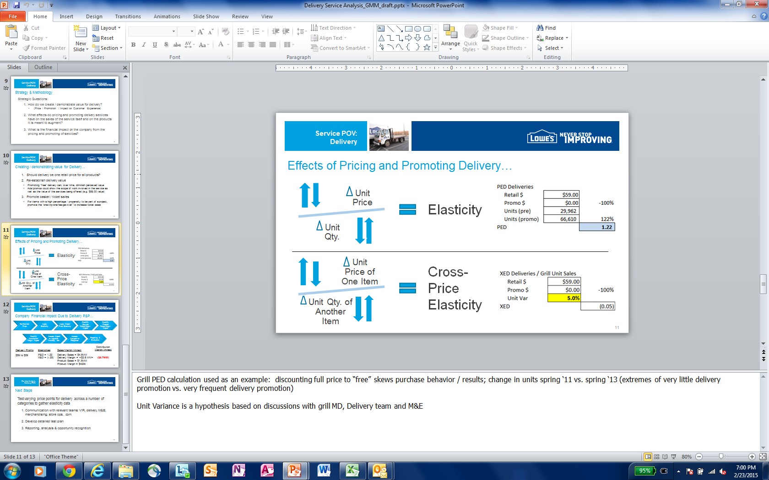
Price Elasticity and Analyzing Service Impact
Data:
New Ways to Quantify Impact
© 2014 Lowe’s. All rights reserved. CONFIDENTIAL, intended for internal distribution only. .

Slide 14
Where does data visualization fit?
Data Analytics: Process & Partnership
Acquire Data
Clean Data
Explore Data
Data Modeling
Insights
Communicate
© 2014 Lowe’s. All rights reserved. CONFIDENTIAL, intended for internal distribution only. .

Slide 15
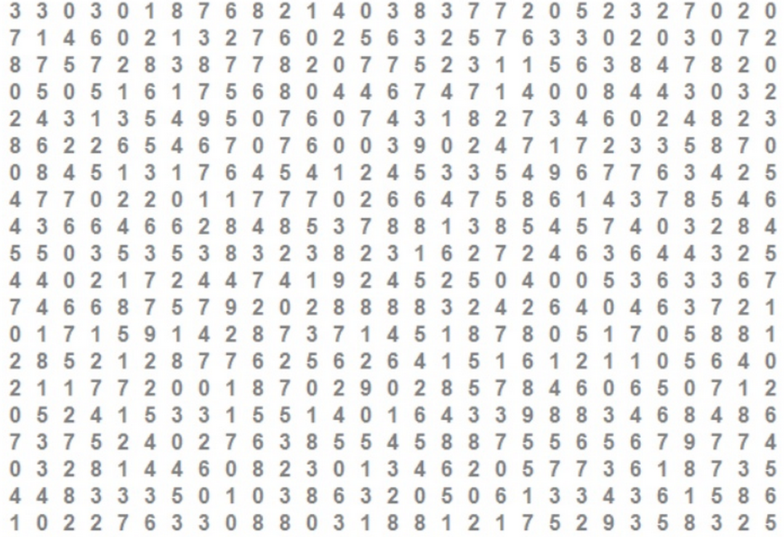
Data Visualization
© 2014 Lowe’s. All rights reserved. CONFIDENTIAL, intended for internal distribution only. .

Slide 16
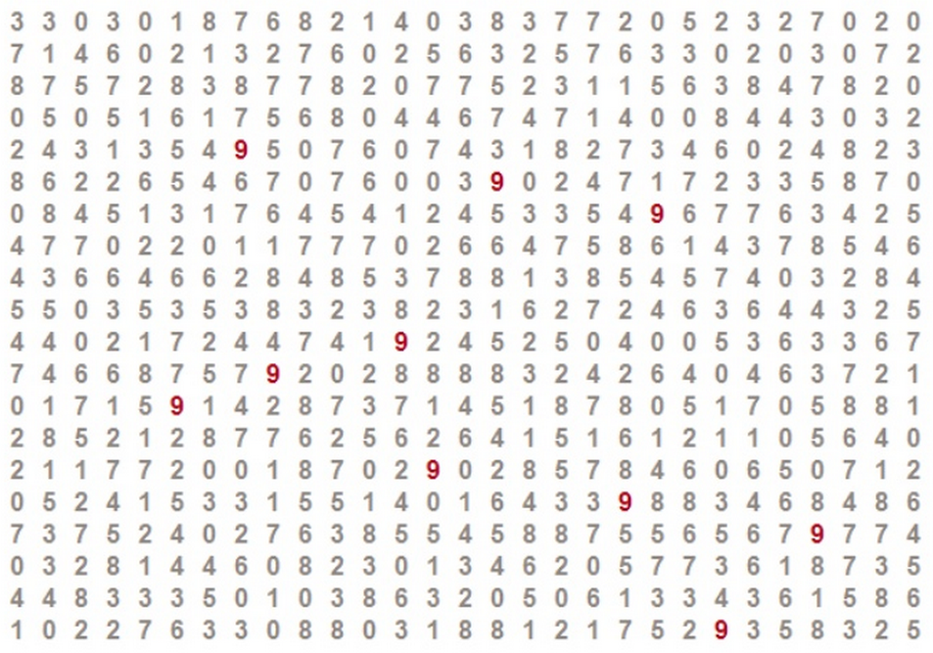
Data Visualization
© 2014 Lowe’s. All rights reserved. CONFIDENTIAL, intended for internal distribution only. .

Slide 17
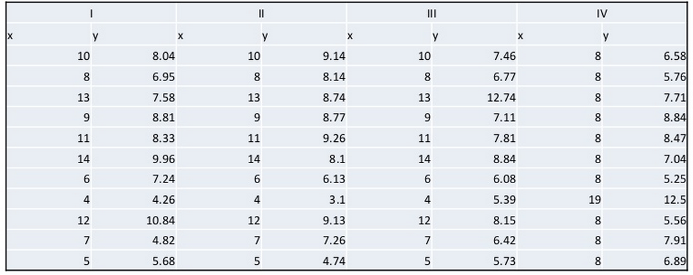
Data Visualization
© 2014 Lowe’s. All rights reserved. CONFIDENTIAL, intended for internal distribution only. .

Slide 18
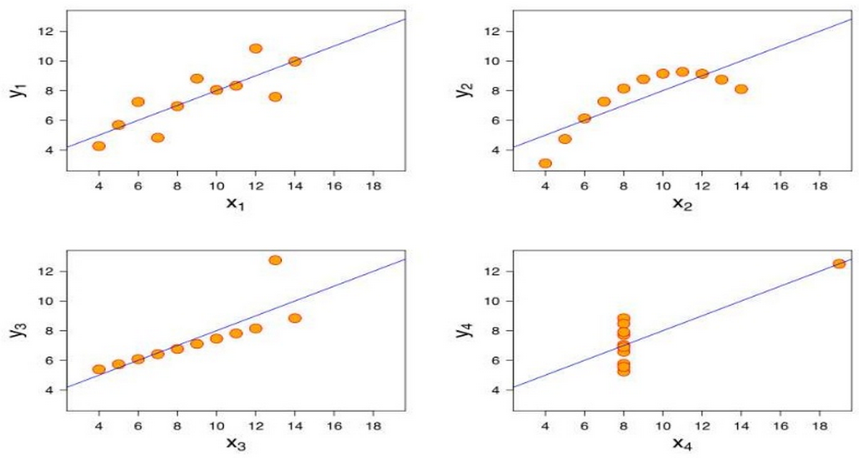
Data Visualization
© 2014 Lowe’s. All rights reserved. CONFIDENTIAL, intended for internal distribution only. .

Slide 19
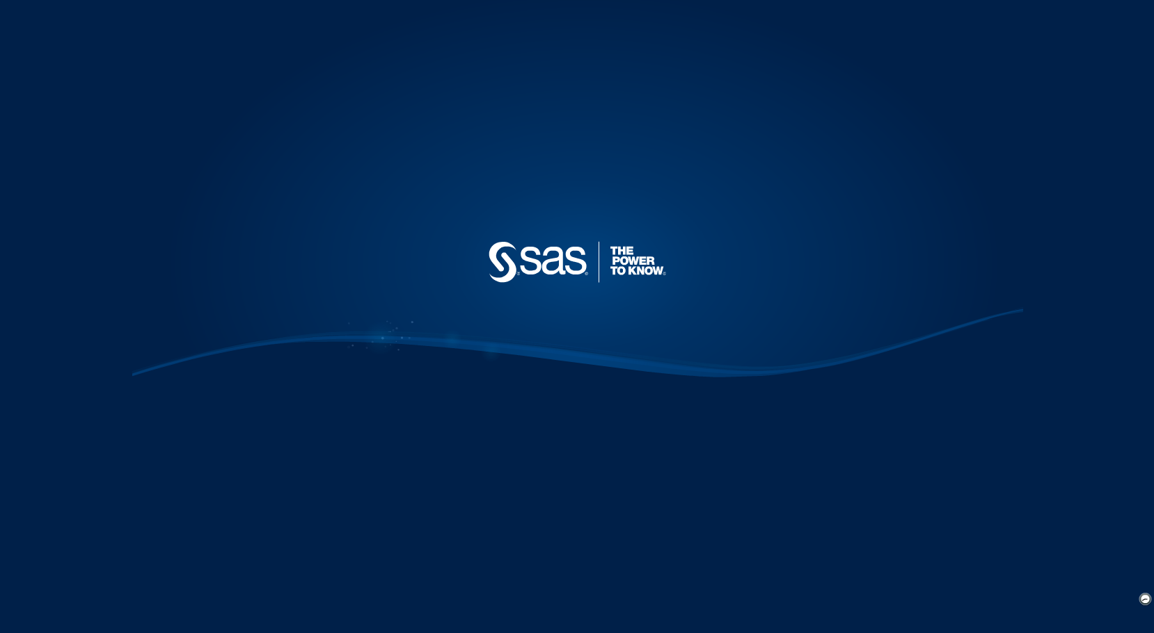
Data Visualization
Partnering with M&E…
… led to new & powerful ways to look at credit data.
© 2014 Lowe’s. All rights reserved. CONFIDENTIAL, intended for internal distribution only. .

Slide 20
Where does data visualization fit?
Data Analytics: Process & Partnership
Acquire Data
Clean Data
Explore Data
Data Modeling
Insights
Communicate
© 2014 Lowe’s. All rights reserved. CONFIDENTIAL, intended for internal distribution only. .

Slide 21
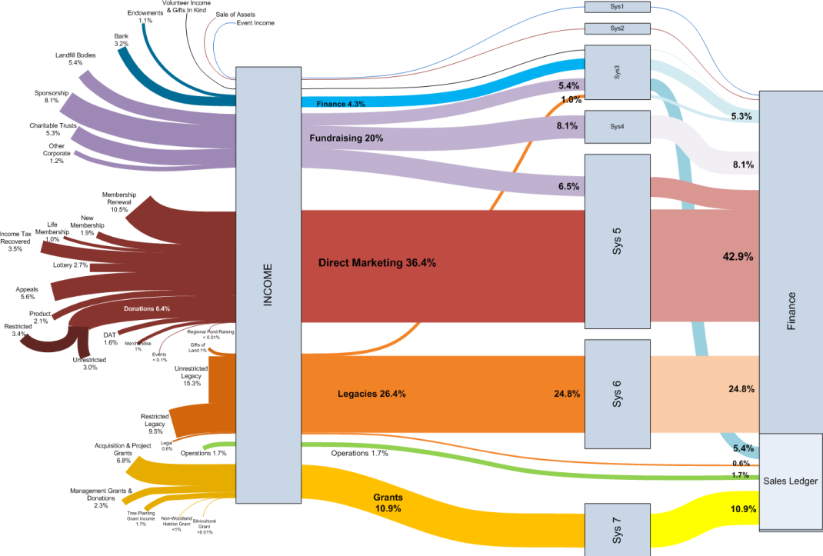
Data Communication
© 2014 Lowe’s. All rights reserved. CONFIDENTIAL, intended for internal distribution only. .

Slide 22
New Guidance Documents Utilizing CCI Data and M&E Custom Reporting
Insights to Guide Merchandising
DIY & PRO
© 2014 Lowe’s. All rights reserved. CONFIDENTIAL, intended for internal distribution only. .

Slide 23
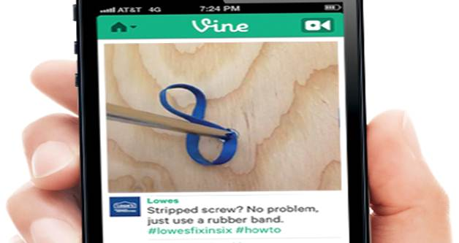
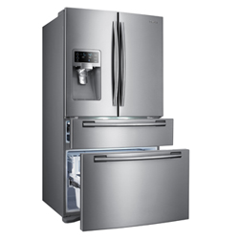
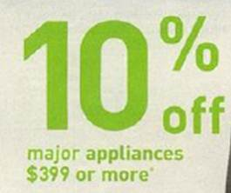
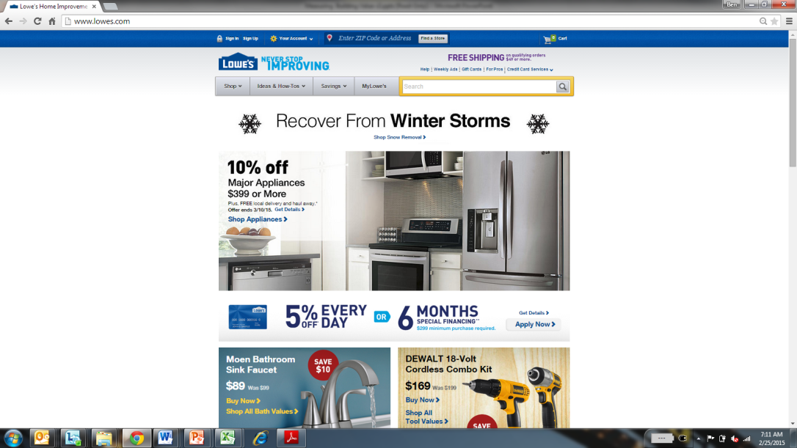
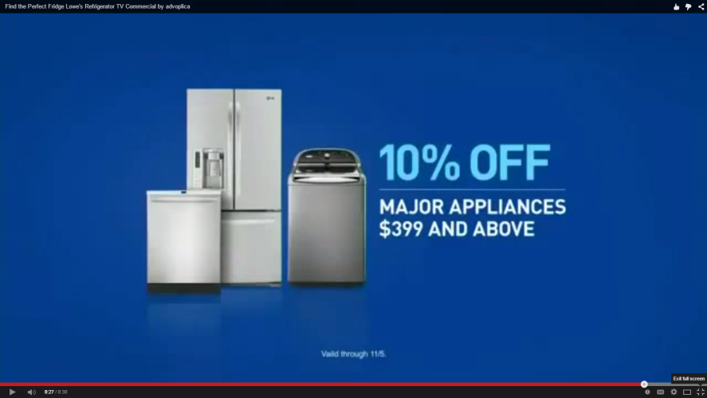
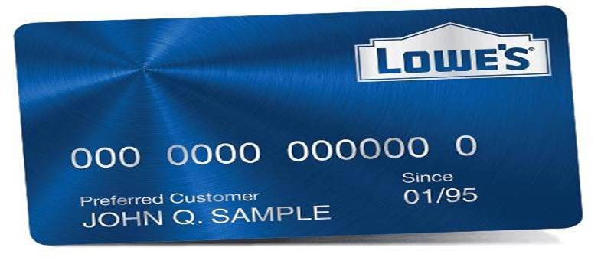
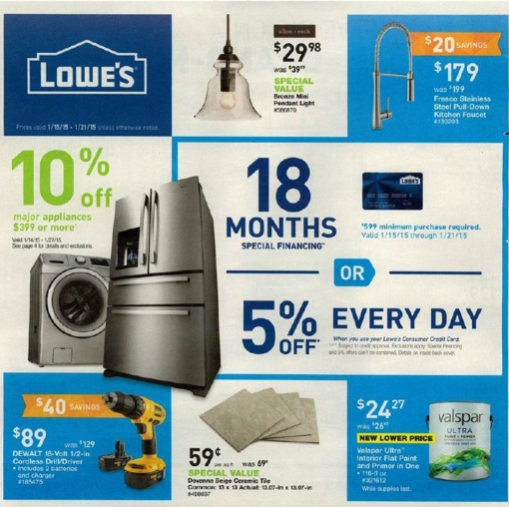
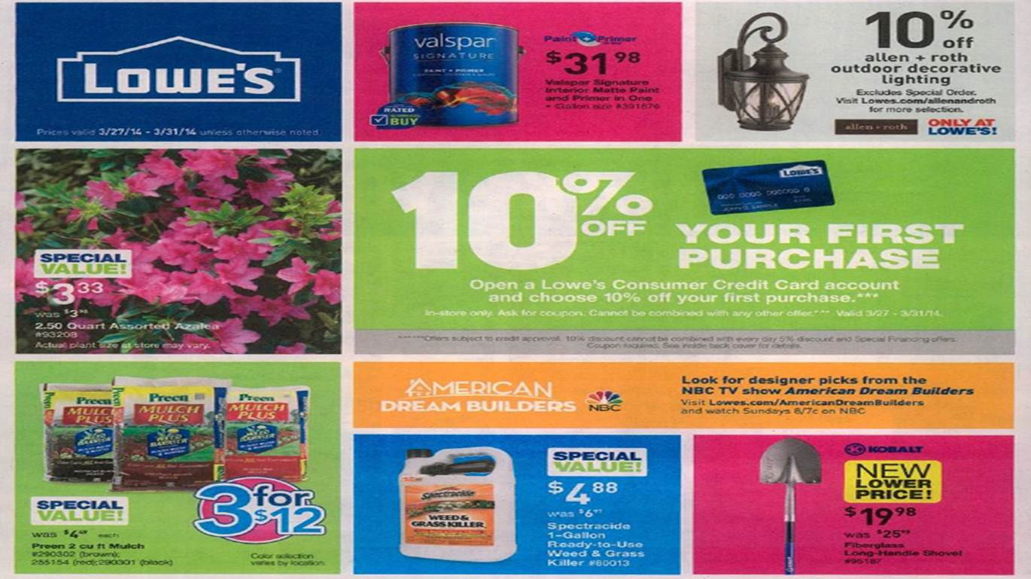
Planning &
Implementation
Planning & Implementation (P&I) acts as Lowe’s promotional subject matter experts. P&I leverages various inputs to identify products, promos, channels, and timing for omni-channel Seasonal Promotional Plans. Performance is evaluated to influence future plans.
Promo Performance Analysis & Feedback
Marketing Strategy
Merchandising Priorities
Promotional Strategy
P&I
Corporate Initiatives
Key Value Items
Seasonal Promo Plans
© 2014 Lowe’s. All rights reserved. CONFIDENTIAL, intended for internal distribution only. .
23

Slide 24
Cross-Functional Wins
Surgical Pricing
Strategic raising and lowering of item prices to drive different metrics
Q4 Incremental Margin Results
Surgical Pricing: $27,006,397
Merchant Tactics: $9,148,970
Total: $36,155,367
KVI Strategy
Driving customer price perception by pricing and promoting KVIs
Trim-a-Tree
Geographic analysis driving inventory, pricing and mark-down timing decisions
Credit Strategy
Increase in Net Credit Income of $46MM
© 2014 Lowe’s. All rights reserved. CONFIDENTIAL, intended for internal distribution only. .

Slide 25
Cross-Functional Wins
Contractor Pack Modeling
Seasonal Promotions Planning
California Compliant Signage and Labels
Net Value Messaging (with stacked promotions)
DIY & PRO Insight Documents
Top Priority Given to New Pricing Tools and Systems
Price & promotion management, strategy and competitive intelligence
© 2014 Lowe’s. All rights reserved. CONFIDENTIAL, intended for internal distribution only. .

Slide 26
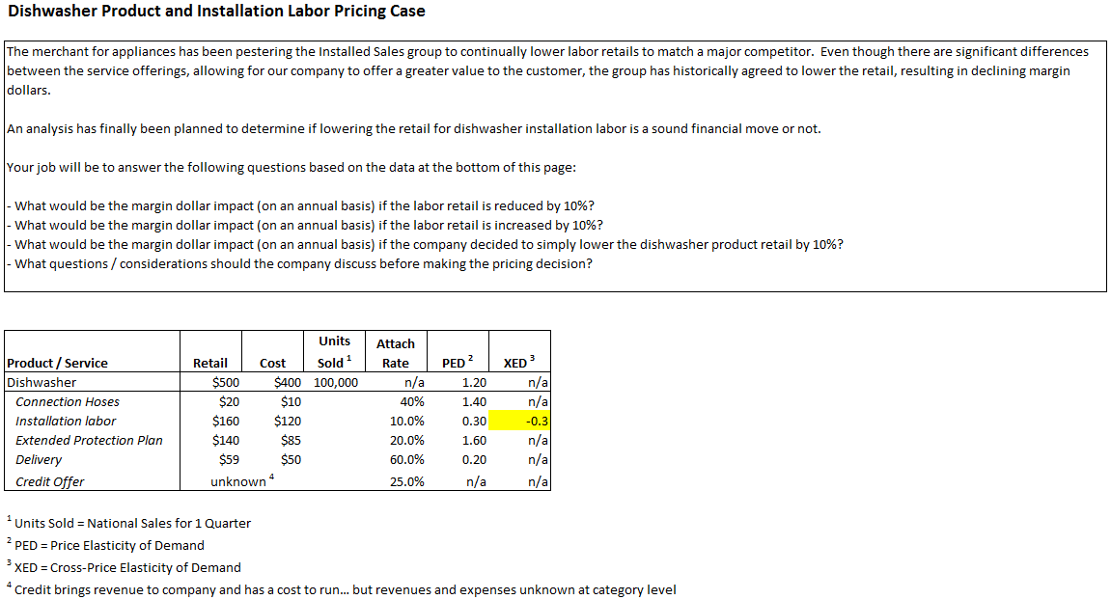
Exercise
© 2014 Lowe’s. All rights reserved. CONFIDENTIAL, intended for internal distribution only. .

